Slide 1
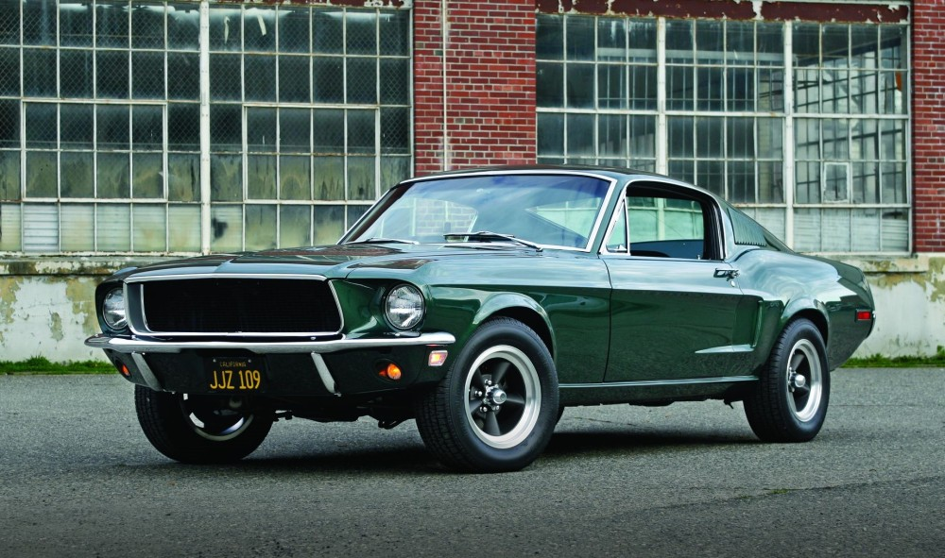
HOME
Sign in
BUY SELL TRADE Mustangs HOF
1968 Mustang
Featured Item
Condition: New
Owner: Private
Miles: 15,000
Engine Type: Coyote 5.0
Price: $68,000
CLICK HERE FOR MORE INFO

Slide 2
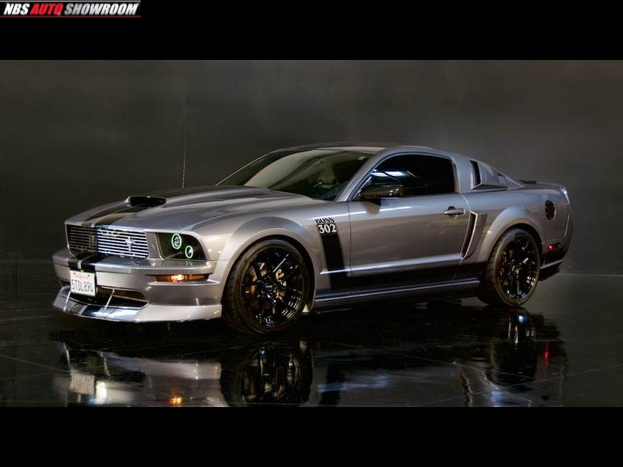

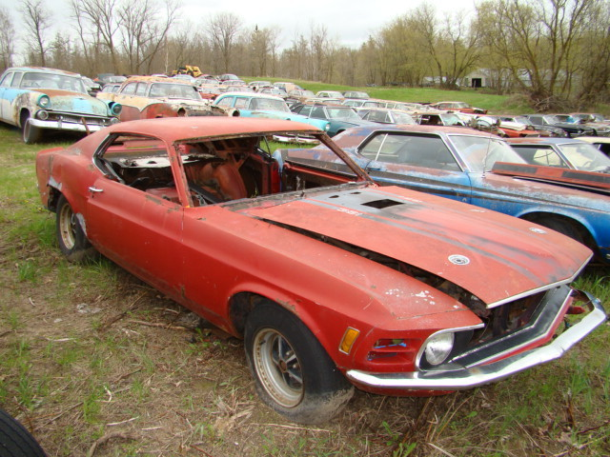
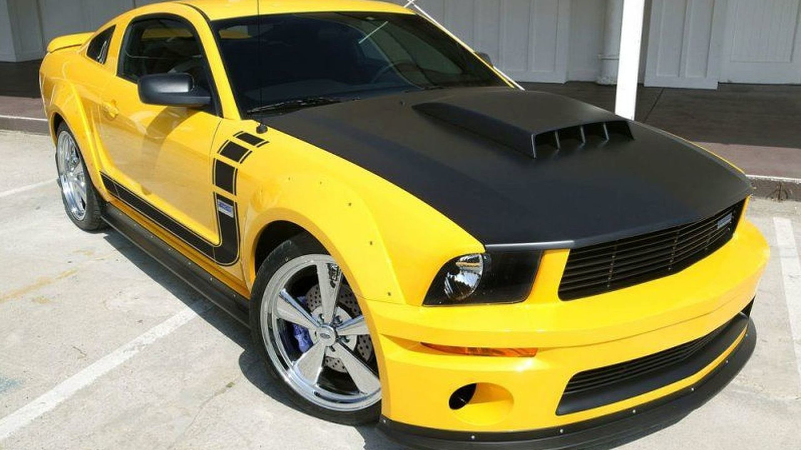
BUY
Username
Price: 25,000
Click Image for more details
Price $65,000
Click Image for more details
Price: $5,000
Click Image for more details
Price: 35,000
Click Image for more details
Next Page

Slide 3
SELL
Username
Present Auctions
Past Auctions
Drafts
Insert Image our Auction Here…
Condition:
Owner:
Miles:
Engine Type:
Price:
Description about car….

Slide 4
TRADE
Username
Post a Trade Here:
Trades you are looking for:
Past Trades:
What you are looking for….
Car year:
Price Range:
Engine Type:
You have no past trades.
What you have…..
SEARCH

Slide 5
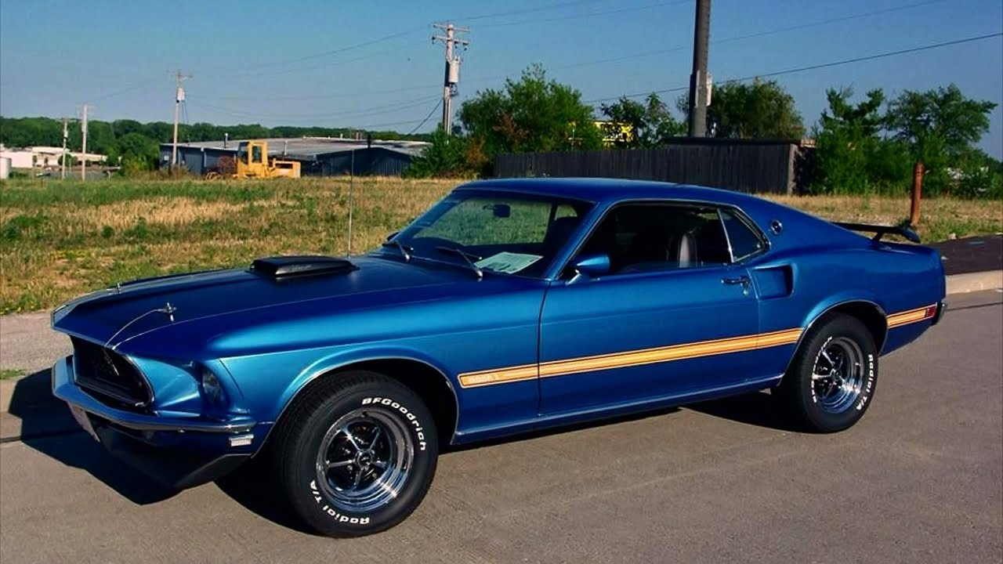
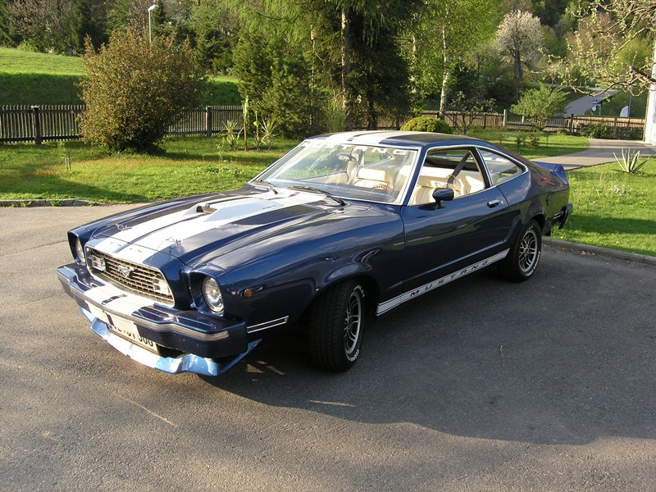
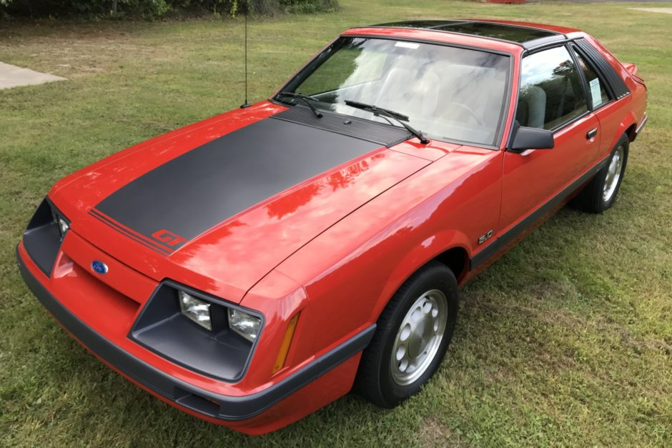
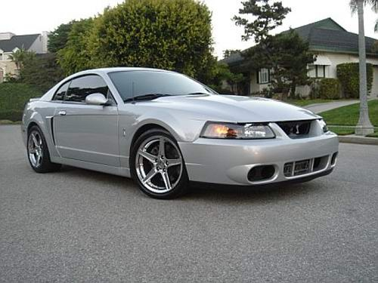
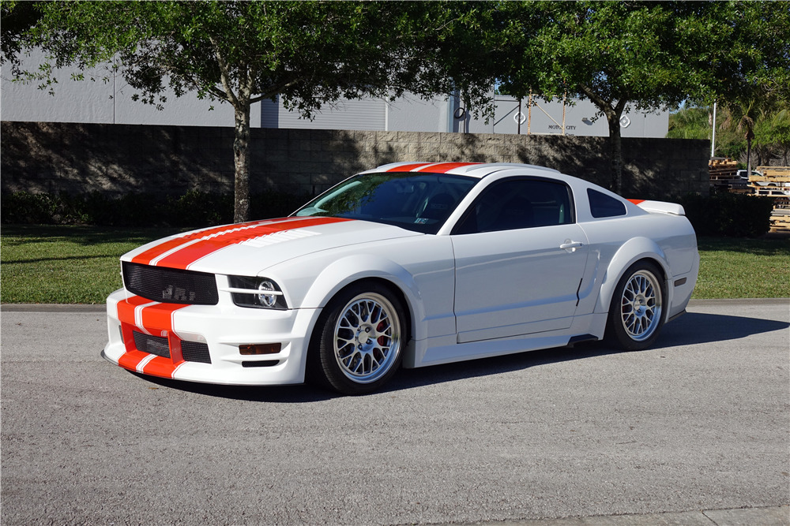
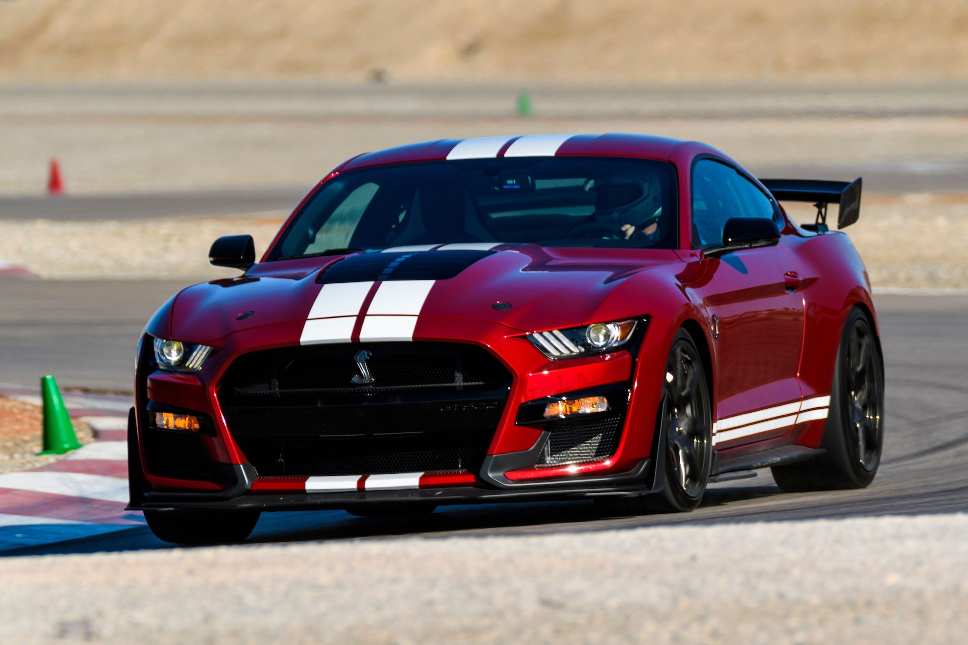
The Mustang HOF
1968 Mustang Mach 1
1975 Mustang Cobra
1985 Mustang 5.0
2004 Mustang Shelby
2006 Mustang GT
2020 Mustang GT500

